Slide 1
Impact of Emerging Technology on the Automation and Manufacturing Industry

Slide 2
Introduction: Embracing Change in Manufacturing
The landscape of manufacturing and automation has undergone a radical transformation with the advent of emerging technologies. In recent years, technologies such as Artificial Intelligence (AI), Internet of Things (IoT), Robotics, and 3D Printing have not only reshaped traditional manufacturing processes but have also ushered in a new era of efficiency, customization, and adaptability. This essay explores the multifaceted effects of these technologies on manufacturing and automation, examining the positive impacts, challenges, and future possibilities.
Historically, manufacturing relied heavily on manual labor-intensive processes. The Industrial Revolution marked the beginning of mechanization, introducing steam-powered machinery to enhance production capabilities. However, it was the 20th century that witnessed a significant shift towards automation. Assembly lines and mass production techniques became the norm, bringing about increased efficiency but limiting customization and flexibility.

Slide 3
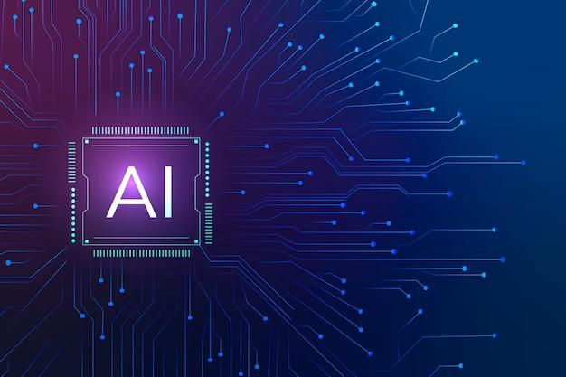
Key Technologies Impacting the Industry
Artificial Intelligence (AI)
The integration of AI in manufacturing has been a game-changer. Machine learning algorithms, capable of analyzing vast datasets, have paved the way for predictive maintenance, reducing downtime and minimizing disruptions in production. AI's ability to optimize production schedules and resource allocation has significantly enhanced efficiency and resource utilization.

Slide 4
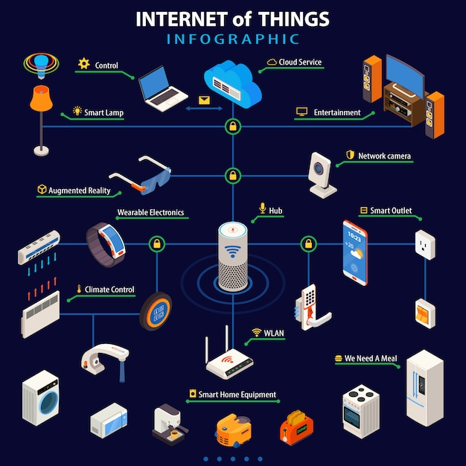
Key Technologies Impacting the Industry
Internet of Things (IoT)
The interconnected web of devices and sensors comprising the IoT has revolutionized manufacturing processes. Real-time monitoring and control of machinery and systems allow for proactive decision-making. This connectivity facilitates data exchange between devices, providing valuable insights that can be leveraged for process optimization and predictive analytics.

Slide 5
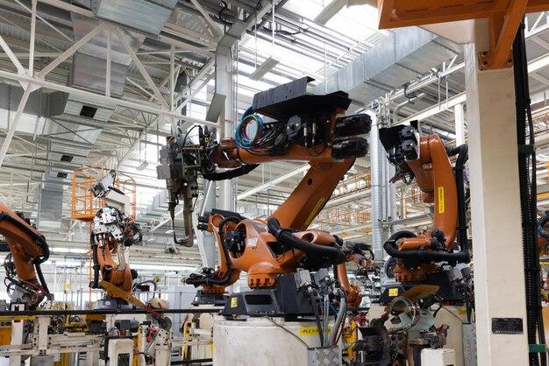
Key Technologies Impacting the Industry
Robotics
The evolution of robotics in manufacturing has transcended conventional automation. Advanced robotic systems have taken center stage in assembly lines, performing intricate tasks with precision and speed. Collaborative robots, or cobots, have emerged, working alongside human counterparts, enhancing productivity and efficiency while ensuring safety.

Slide 6
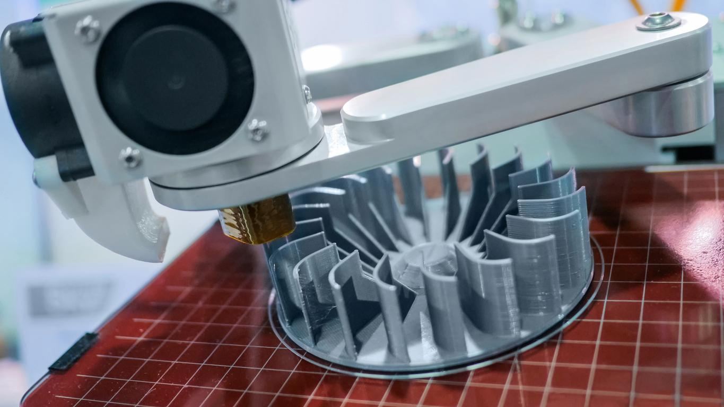
Key Technologies Impacting the Industry
3D Printing
The advent of 3D printing has revolutionized prototyping and product development. This technology allows for the creation of complex, customized components with unprecedented speed and accuracy. The ability to produce on-demand and reduce waste has transformed traditional manufacturing paradigms.

Slide 7
Positive Impacts on Manufacturing and Automation
Increased Efficiency
The infusion of emerging technologies has streamlined manufacturing processes, reducing bottlenecks and improving overall efficiency. Automation insures consistent production rates and eliminated the variability associated with human labor, leading to enhanced operational efficiency.
Cost Reduction
Automation, driven by emerging technologies, has significantly reduced labor costs. While initial investment in technology implementation can be substantial, the long-term benefits include lower operational costs, increased productivity, and a reduction in human errors. Energy-efficient technologies further contribute to cost savings.
Improved Product Quality
Consistency in manufacturing processes, facilitated by automation and emerging technologies, results in improved product quality. The precision and repeatability of robotic systems and AI-driven processes lead to a reduction in defects and ensure that products meet or exceed stringent quality standards.

Slide 8
Challenges and Considerations
Job Displacement
One of the most pressing concerns associated with the rise of automation is the potential displacement of human workers. As machines take over routine and repetitive tasks, the workforce may face job redundancies. Addressing this challenge requires proactive measures, such as upskilling programs and policies that promote a smooth transition to a more automated manufacturing landscape.
Security Concerns
The interconnected nature of emerging technologies in manufacturing raises cybersecurity concerns. With the increased reliance on data exchange and connectivity, the industry becomes vulnerable to cyber threats. Safeguarding manufacturing systems against unauthorized access, data breaches, and other cybersecurity risks is imperative to ensure the integrity and confidentiality of sensitive information.
Ethical Considerations
As AI and robotics become more prevalent in manufacturing, ethical considerations come to the forefront. Responsible AI usage involves addressing issues related to bias, transparency, and accountability. Striking a balance between efficiency gains and ethical considerations is crucial for the successful integration of these technologies into manufacturing processes.

Slide 9
Future Trends and Possibilities
Continued Integration of AI
The trajectory of AI integration into manufacturing is expected to continue, with machine learning algorithms evolving to handle more complex tasks. Cognitive automation, where AI systems emulate human cognitive functions, holds the potential to revolutionize decision-making processes in manufacturing, further enhancing efficiency and adaptability.
Advancements in Robotics
The future of robotics in manufacturing is marked by advancements in dexterity, adaptability, and human-robot collaboration. Robots with increased capabilities to handle delicate tasks and work alongside humans in a collaborative manner will become integral to the manufacturing landscape. This shift will not only improve productivity but also address ethical concerns related to job displacement.
Sustainable Manufacturing
Emerging technologies will play a pivotal role in promoting sustainable manufacturing practices. Eco-friendly materials, energy-efficient processes, and waste reduction strategies will be integrated into manufacturing systems. The concept of a circular economy, where resources are reused and recycled, will gain prominence, contributing to a more sustainable and environmentally friendly manufacturing sector.

Slide 10
Conclusion
The integration of emerging technologies into manufacturing and automation has resulted in a paradigm shift, bringing about unprecedented levels of efficiency, customization, and adaptability. While the positive impacts are evident in increased productivity, cost reduction, and improved product quality, challenges such as job displacement, security concerns, and ethical considerations must be carefully navigated. The future holds exciting possibilities, with continued advancements in AI, robotics, and sustainable manufacturing practices shaping the trajectory of the industry. Balancing technological innovation with ethical considerations will be paramount in ensuring a harmonious transition to a more automated and technologically advanced manufacturing landscape.

Slide 11
References
1.https://www.ibm.com/blog/manufacturing-trends/
2.https://www.forbes.com/sites/forbesbooksauthors/2021/03/25/the-impact-of-technology-and-automation-on-todays-businesses/
3.https://www.mckinsey.com/capabilities/operations/our-insights/human-plus-machine-a-new-era-of-automation-in-manufacturing
4.https://www.automate.org/news/5-emerging-technologies-for-manufacturing

